Slide 1
Notes on Usage
See https://github.com/colinoflynn/colins-pcb-intro for latest version of these slides.
See blog post at www.oflynn.com which links to YouTube video presentation(s) of these slides.
My text & photos are CC-SA Licensed – however many images used are not, so if presenting this I leave it up to you to replace them if required.

Slide 2


Slide 3

WARNING ON THIS LECTURE
This topic needs an entire course, maybe several. I’m giving you one lecture.
Entering Ludacris speed…

Slide 4
Background to this Lecture
My PCBs:
~A few hundred designs over the years
Many open source, some very basic some more complex
Some prototype only, some higher volume (>5K)
2 to 12 layers
Lots of small parts & high density (BGA).
I’ve written a few guides over the years on the topic… some of them referenced within here!
Things I haven’t done:
Heavily cost optimized (e.g., > 10K units or consumer electronics)
High-frequency RF (> 6 GHz)

Slide 5
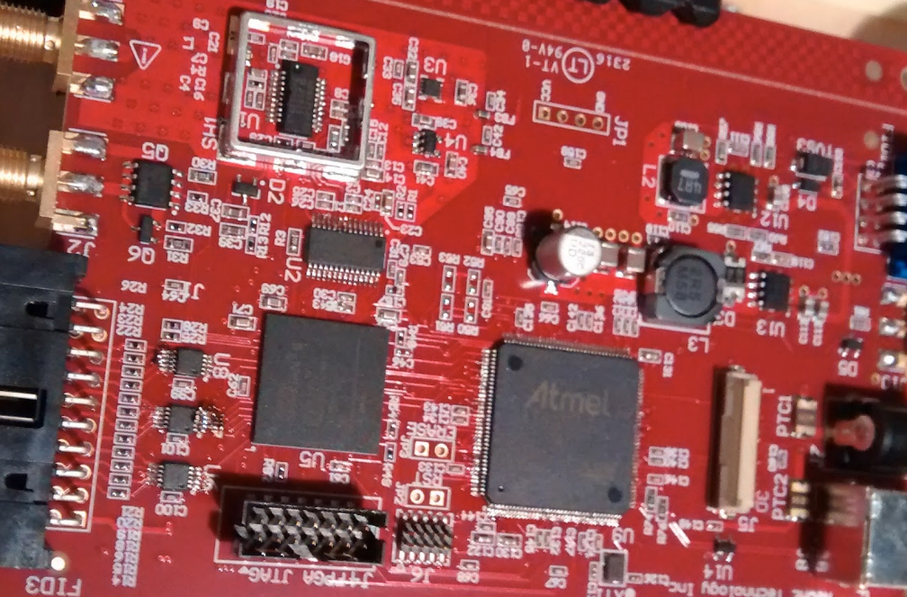
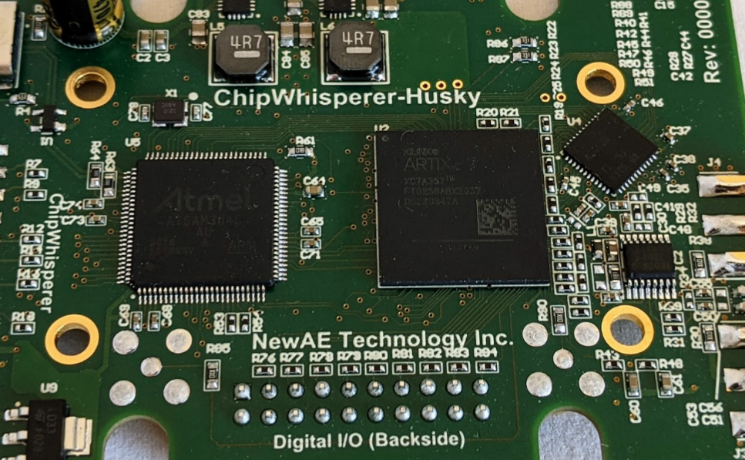
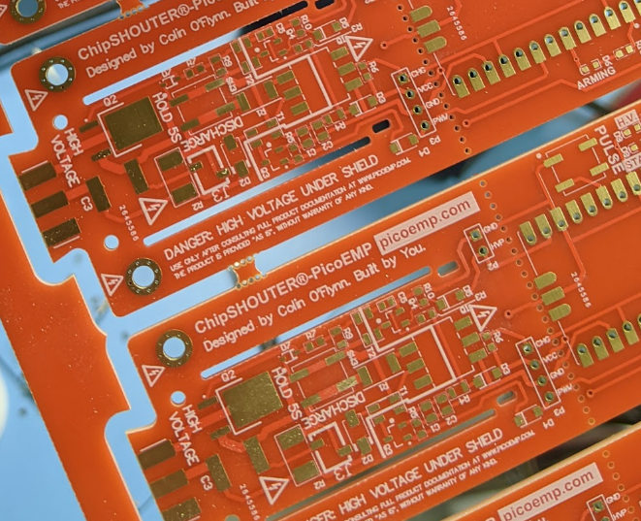
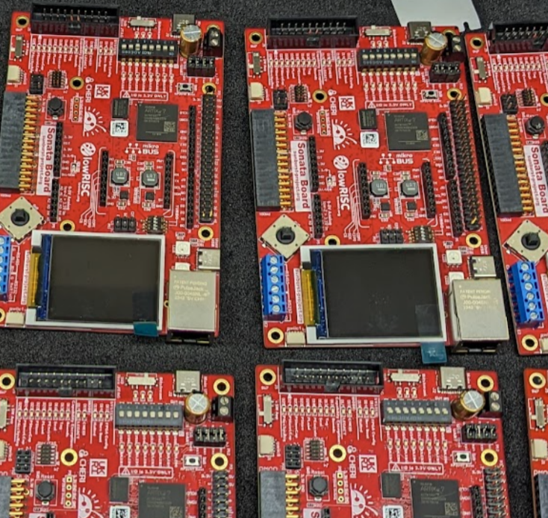
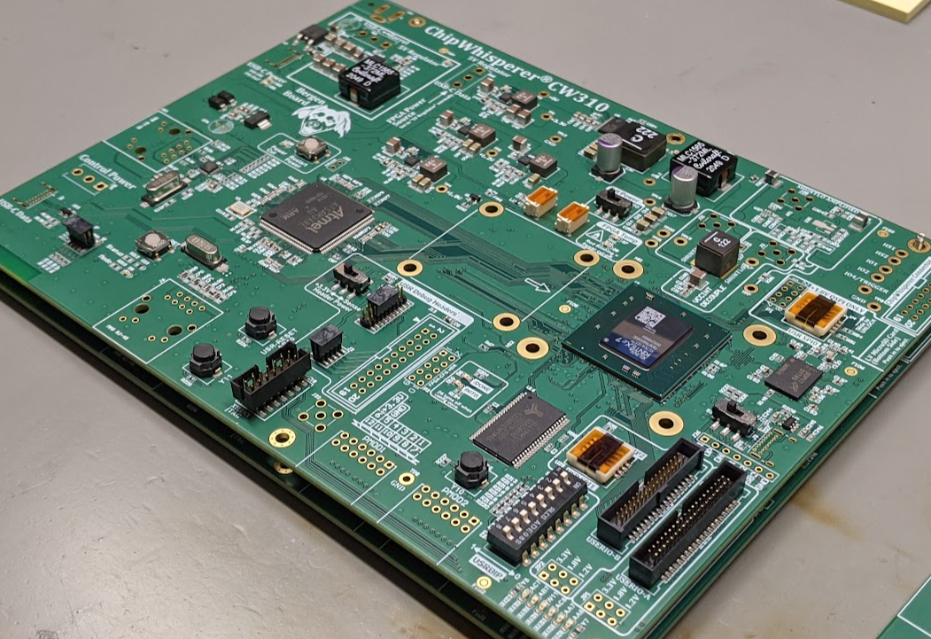
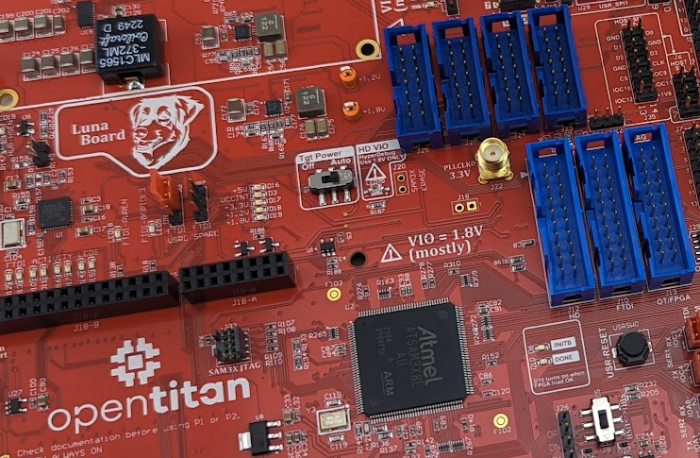
e.g., my PCBs over the years

Slide 6
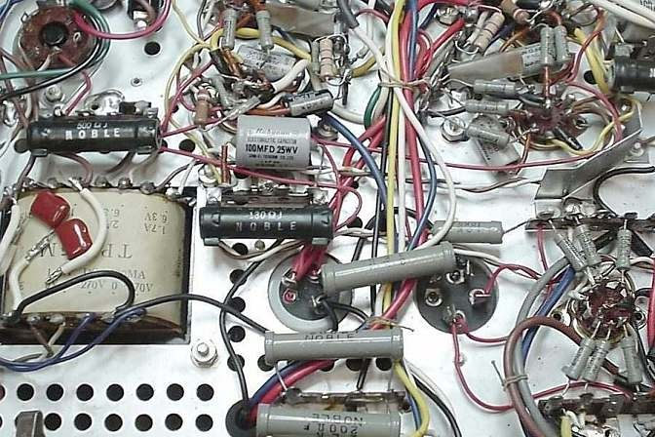
PCBs 101

Slide 7
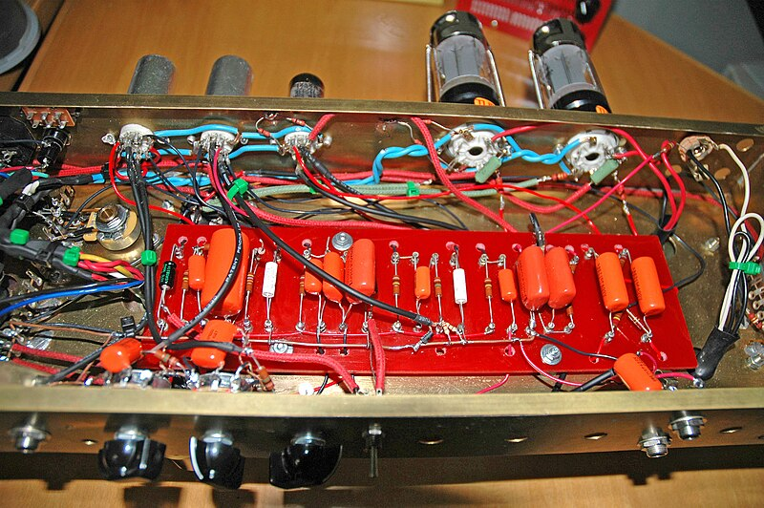
PCBs 101
https://commons.wikimedia.org/wiki/File:Point_to_point_wiring.jpg, CC SA by Mataresephotos

Slide 8
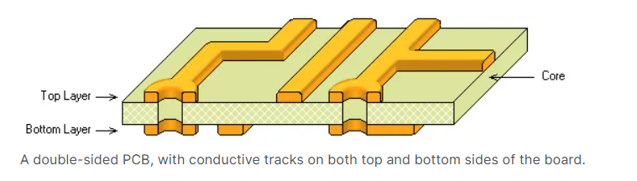
PCBs 101: Basic Board
https://www.altium.com/documentation/altium-nexus/understanding-printed-circuit-board-makeup?version=4#single-sided-board

Slide 9
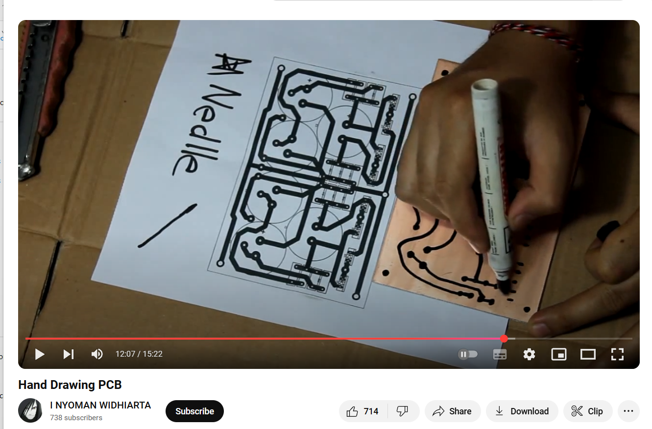
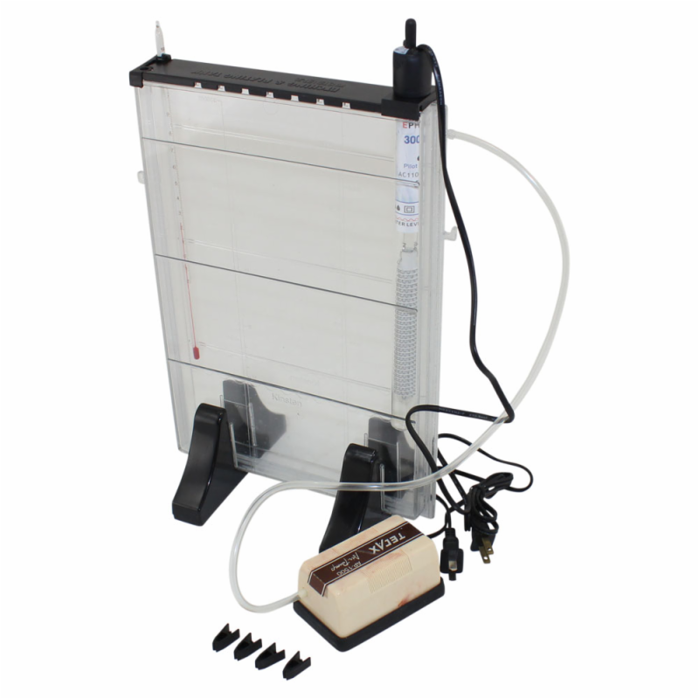

Old PCBs!
https://www.youtube.com/watch?v=URGfZukAs98

Slide 10
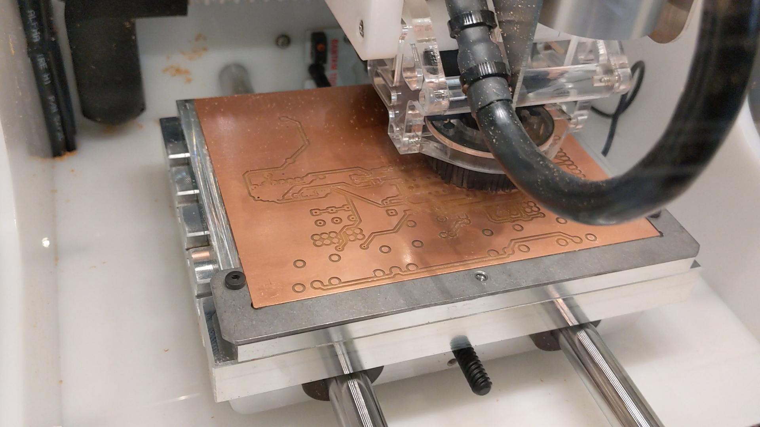
Milled PCBs

Slide 11
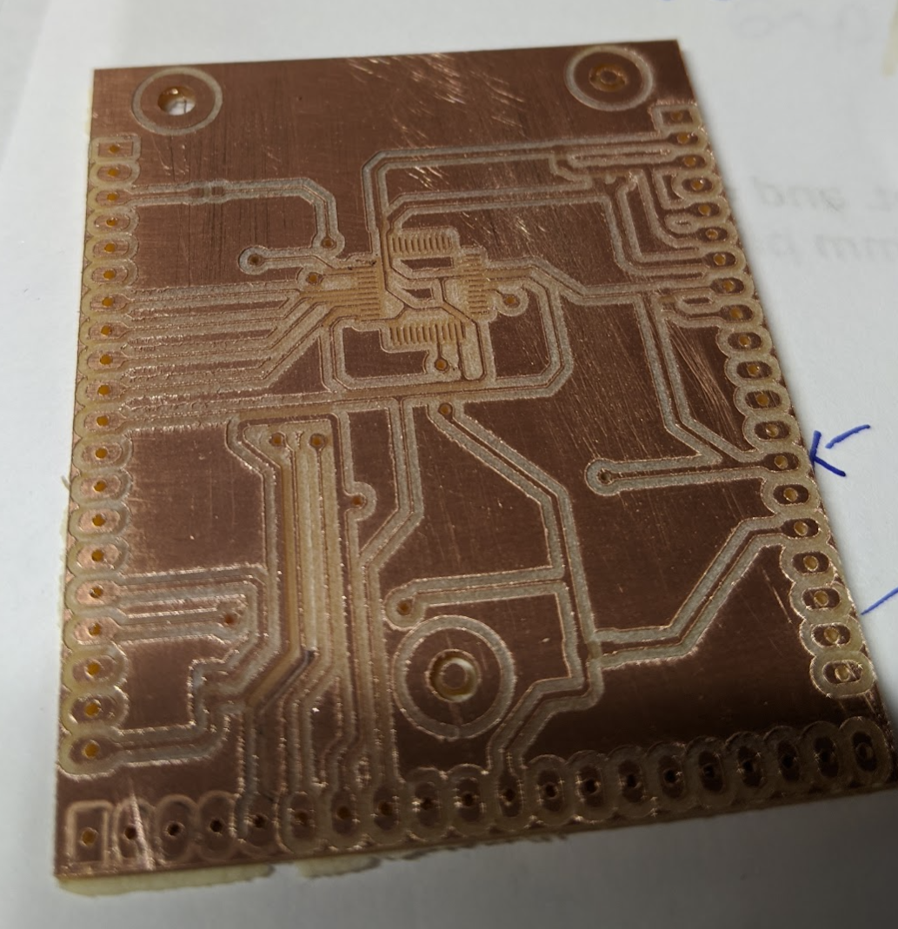
Another simple milled PCB example:

Slide 12
Golden Rule of PCB Design
Design your board for how you plan on getting it made and built.

Slide 13
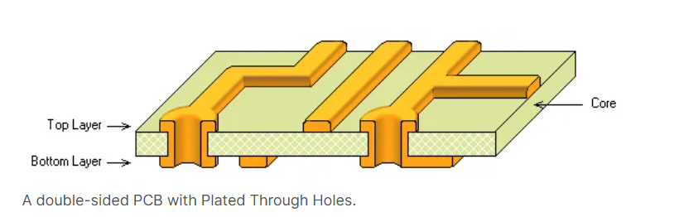
PCBs 101: PTH (Plated Through Holes)
https://www.altium.com/documentation/altium-nexus/understanding-printed-circuit-board-makeup?version=4#single-sided-board

Slide 14
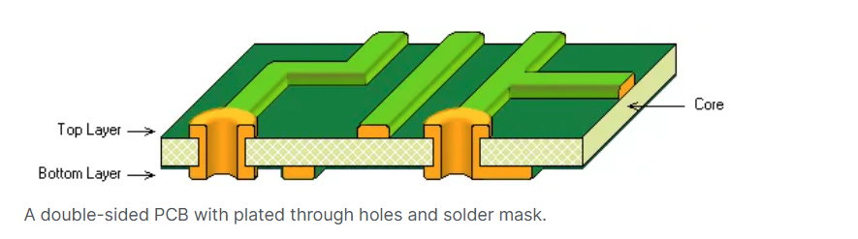
PCBs 101 - Basics

Slide 15
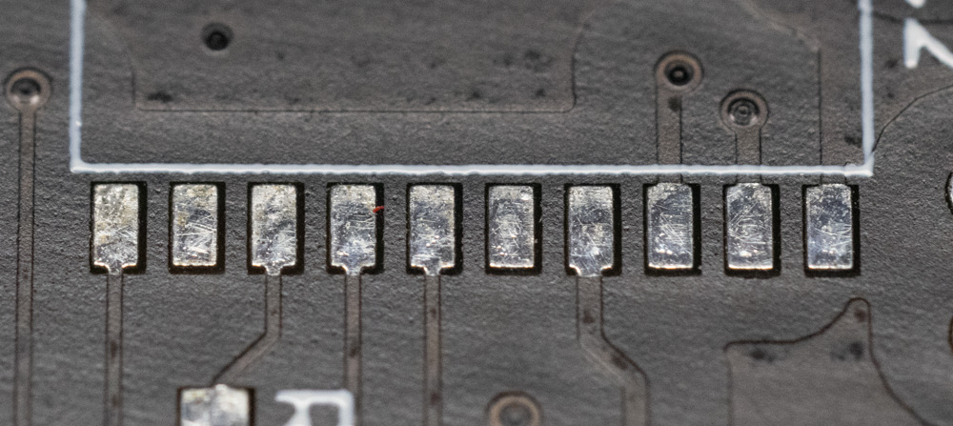
PCBs 101 – Soldermask
Soldermask (Black in this example)
No Soldermask

Slide 16
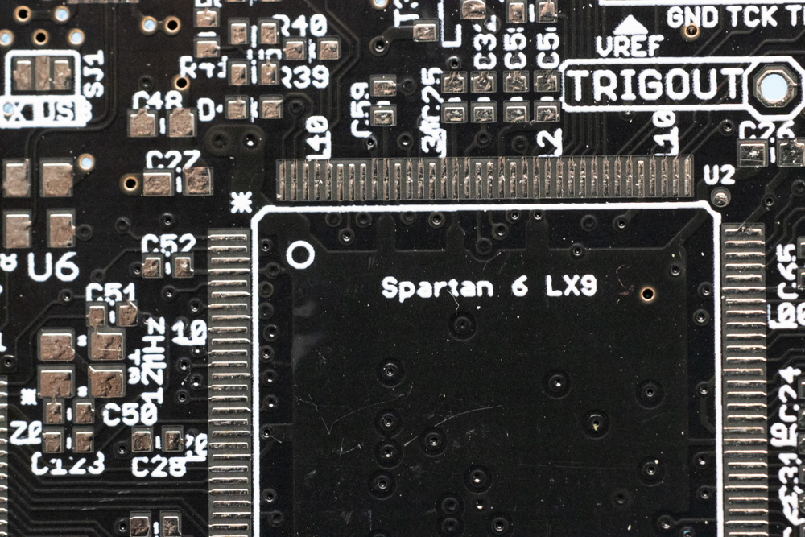
PCBs 101 – Silkscreen
Silkscreen (White)

Slide 17
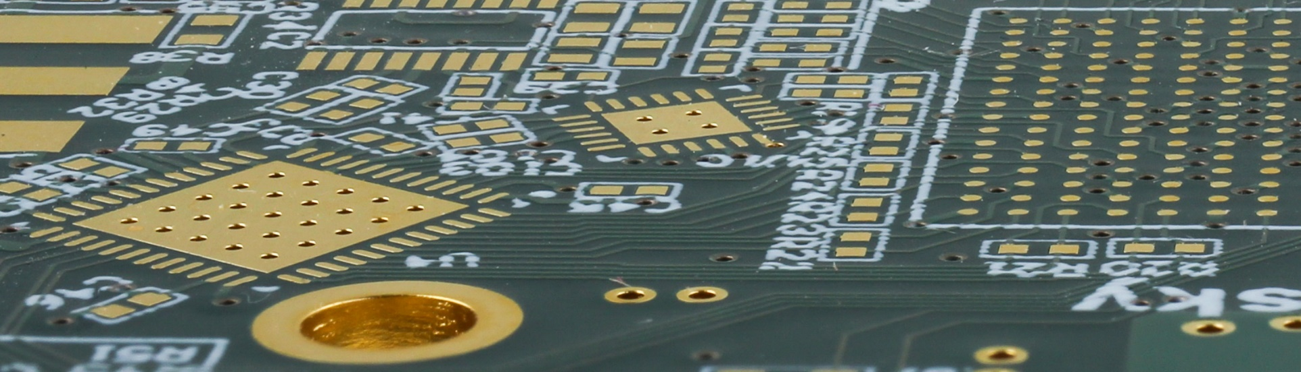
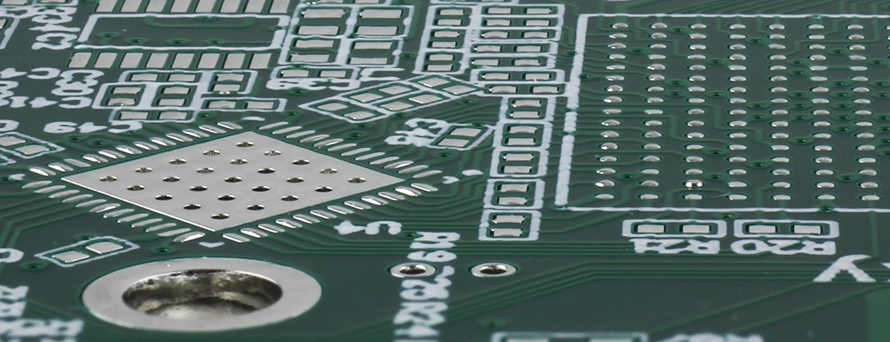
PCBs 101 - Finish
ENIG
HASL

Slide 18
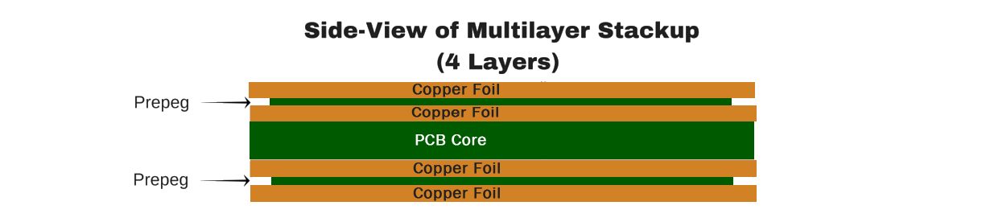
PCBs 101 – More Layers

Slide 19
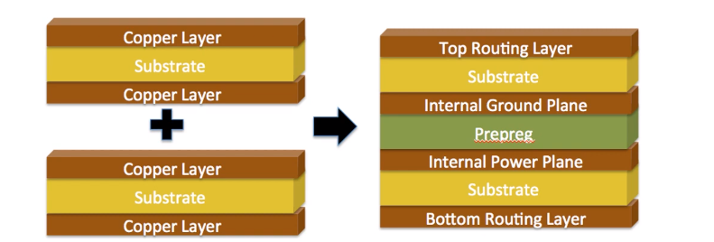
Multi-Layer Lamination Process
https://morepcb.com/pcb-prepreg/

Slide 20
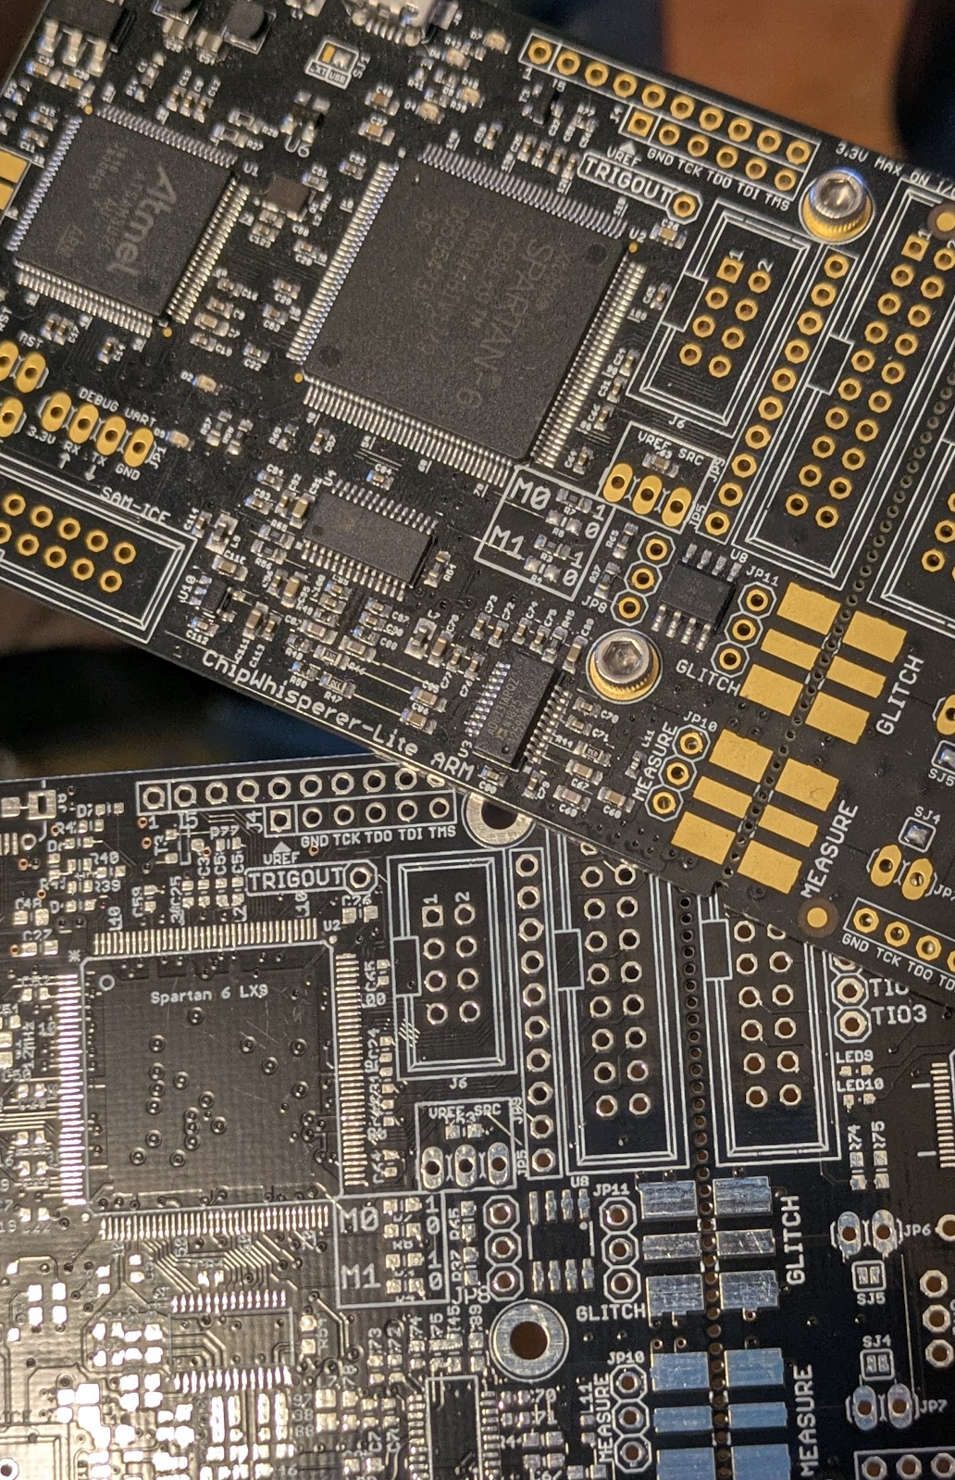
Terminology
PCB-A = Printed Circuit Board Assembly
PCB = Printed Circuit Board

Slide 21
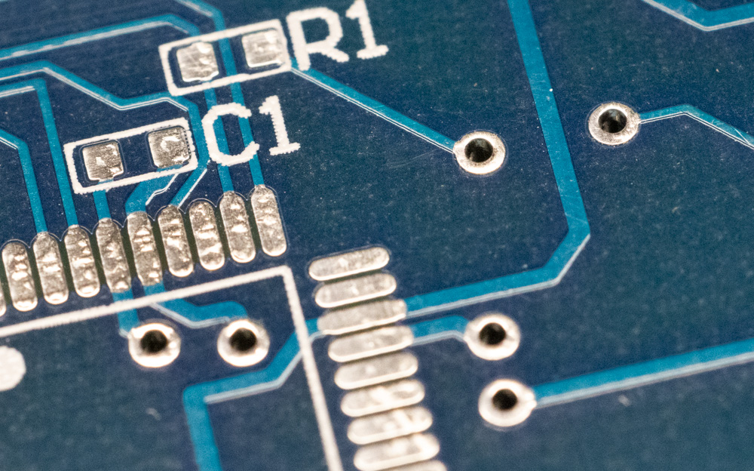
Terminology – Cont’d
Silkscreen
Pad
Via
Soldermask
Drill
Trace

Slide 22




PCB: Design Software?

Slide 23
Part 1: PCB Design Basics

Slide 24
PCB Design Units
Units are normally in mils or mms.
1 mil = 0.001 inch = 0.0254 mm
WARNING: This is unique to PCB design. It’s not a frequently used unit in mechanical design & may be misinterpreted as a something else.
In mechanical design “thou” would be used. Especially outside North America where mm would be more common.

Slide 25
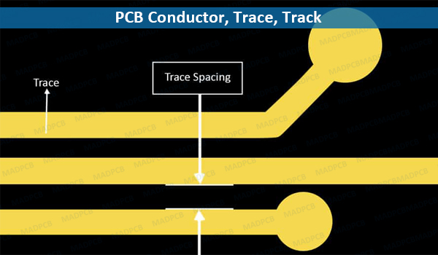
Trace & Space
https://madpcb.com/glossary/conductor/

Slide 26
Trace & Space == $$
Trace & Space of 8 mil (0.2mm) or higher can be produced anywhere.
Trace & Space of 6 mil (0.15 mm) is mostly available.
Trace & Space of 5 mil (0.127 mm) is now common on lower-cost boards, but not universal (OSHPark 2-layer PCBs are 6-mil)
Trace & Space of 4 mil is higher-tech.
Accurate as of 2025 – this has been stable for some time, and little indication we are getting towards “normal” 4 mil trace/space usage.

Slide 27
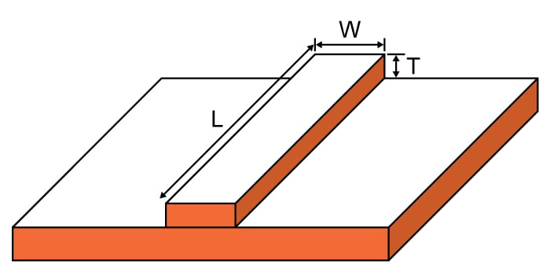
PCB Trace = Resistance & Inductor

Slide 28
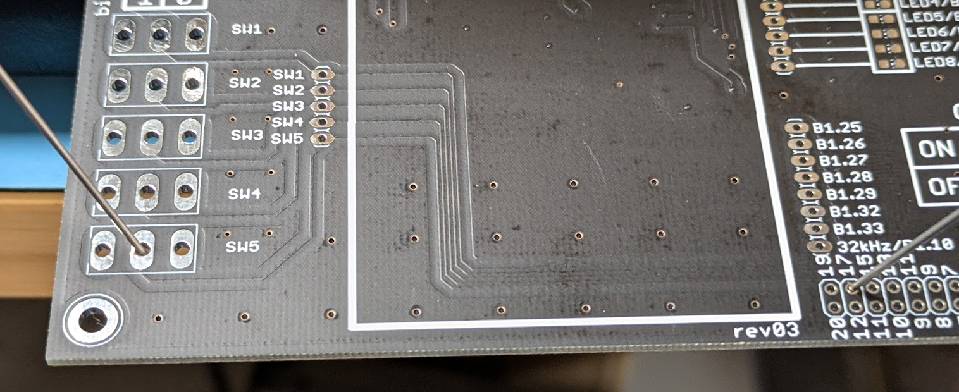
e.g., comparing two PCB traces passing 2A:
Wider
Narrower

Slide 29



Circuit Equivalent:

Slide 30
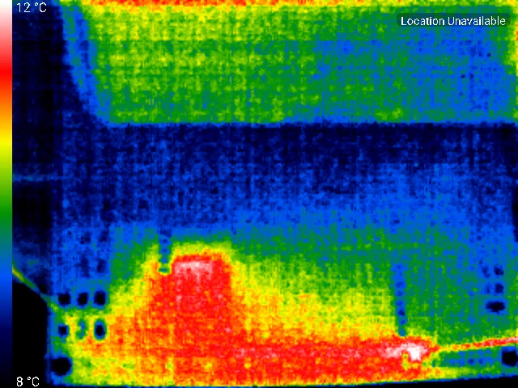

Slide 31
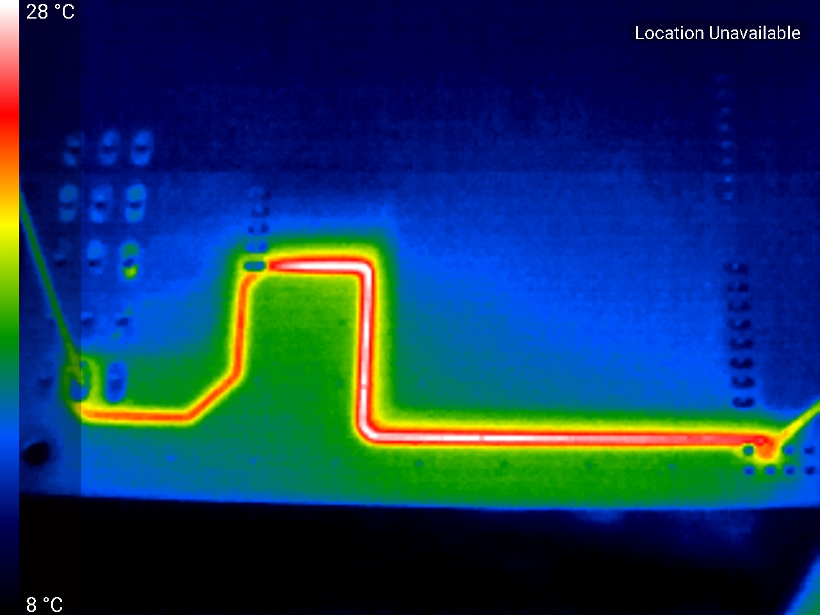

Slide 32
Good Starting Trace Settings
Trace & Space of 8 mil (0.2mm) or higher can be produced anywhere.
Trace & Space of 6 mil (0.15 mm) is mostly available.
Trace & Space of 5 mil (0.127 mm) is now common on lower-cost boards, but not universal (OSHPark 2-layer PCBs are 6-mil).
NOTE: The lower limit of trace & space won’t be as reliable for a process as going above that limit. Always good practice to keep as large a trace & space as your design allows.

Slide 33
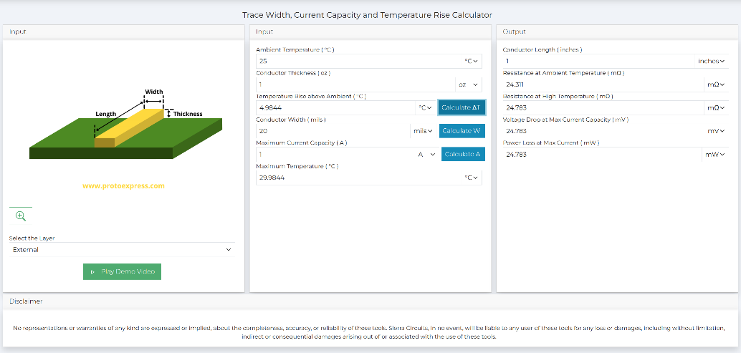
Trace & Space Defaults
Use 10 mil (0.25mm) trace & space is a good initial setting.
Widen power traces to ~20 mils (~0.5mm) or more.
You'll see in Group Project 1 how to calculate temperature rise of a trace.
https://www.protoexpress.com/tools/trace-width-and-current-capacity-calculator/

Slide 34
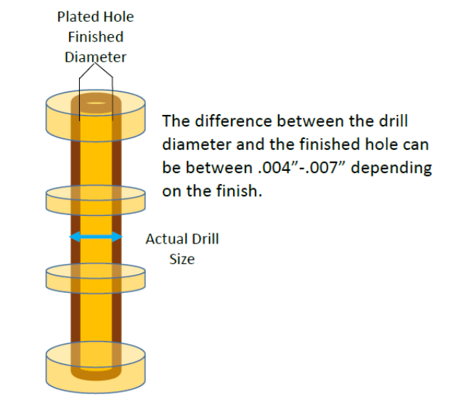
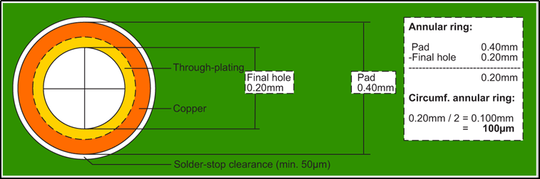
Via & Drill
You are normally specifying the finished hole size.
PCB manufacturer will take care of selecting a drill to get you the required finished hole size you specify in the design software.

Slide 35
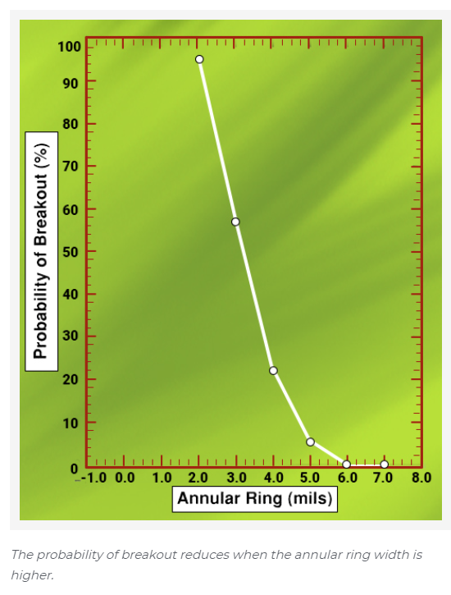
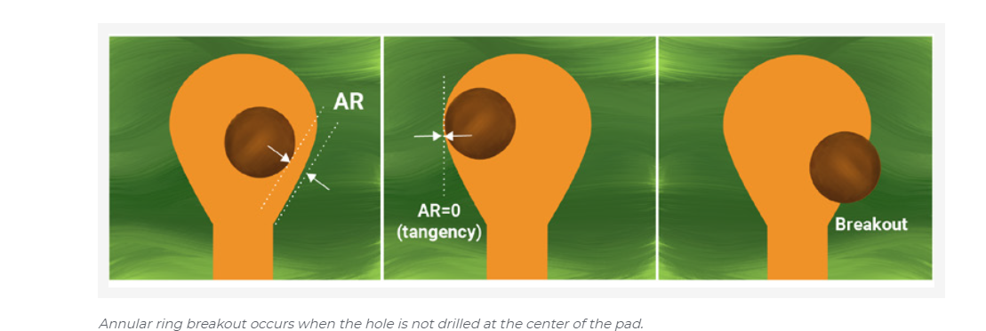
Annular Ring
https://www.protoexpress.com/blog/dont-let-annular-rings-drive-you-crazy

Slide 36
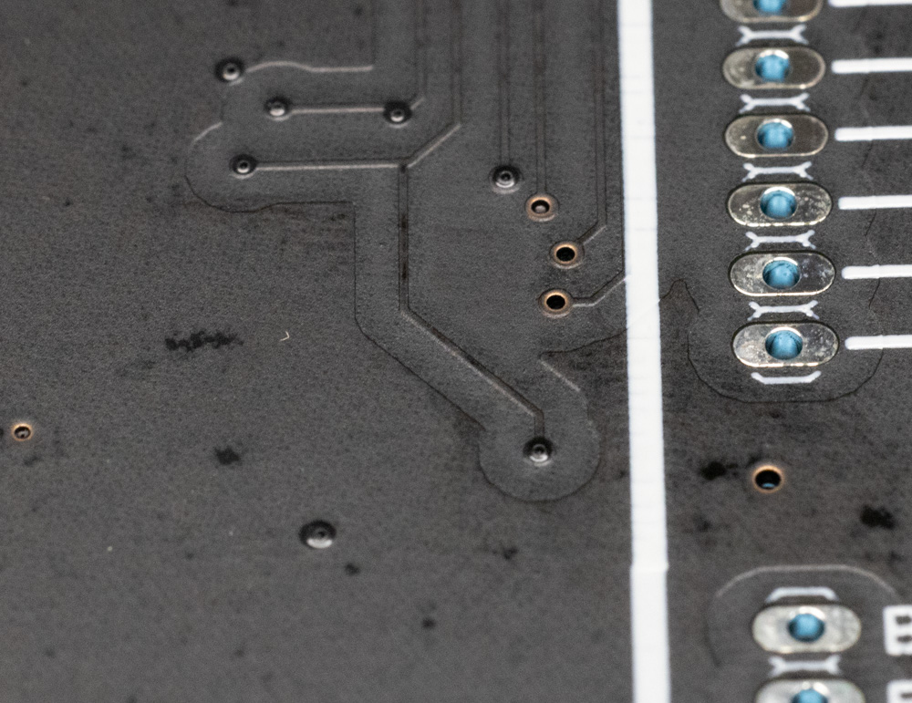
Via Tenting
Tented Via (hole has slight raise)
If soldermask covers the vias they are tented.
Note depending on the drill hole sometimes the soldermask doesn’t cover the hole.
Tented Via
(Hole is clear)

Slide 37

Untented Vias
Why tent vias?
Reduces risk of shorts or solder bridges.
Looks cleaner.
NOTE: Silkscreen cannot go over untented vias.
Why untent vias?
Can use vias as test points.
Easier to modify PCB.
Untented vias are exposed as here.

Slide 38
Typical Via Sizes
Good generic one:
20 mill drill (0.5 mm) & 40 mil (1.0 mm) diameter pad
Smallest size for low-cost:
12 mil drill (0.3mm) & 24 mil (0.6 mm) diameter pad
(Now commonly 8 mil (0.2 mm) drill is available)
For higher power increase size & add several in parallel.
NOTE: We commonly call the hole size the “drill”, even though the actual drill size is different. We rarely know the actual “drill”. Just be aware these are different!

Slide 39
When Designing your PCB:
Check default trace & space settings + via sizes – ensure it matches your process!
It’s a LOT more work to fix this later.

Slide 40
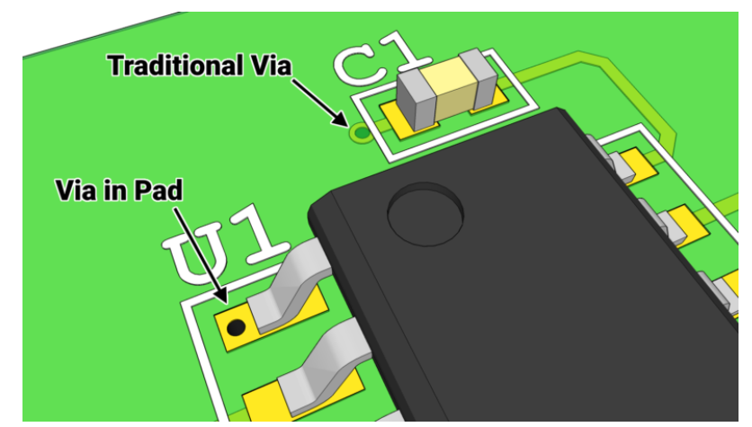
Via in Pad

Slide 41
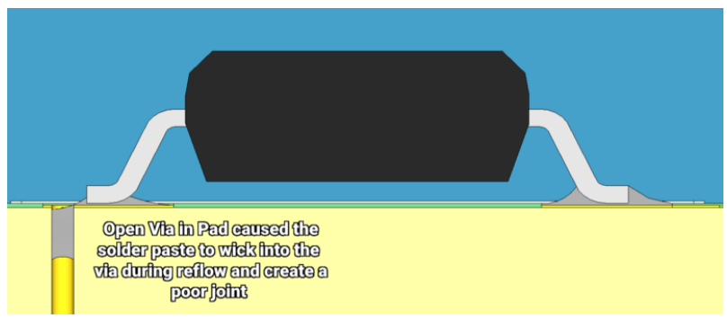
Via in Pad

Slide 42
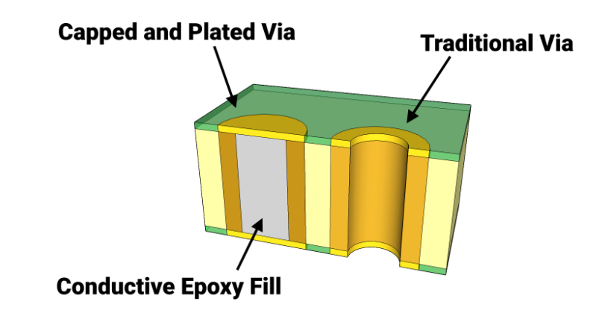
Via in Pad Process
$$$

Slide 43

Do This NOT That:
Baby Jesus Sad
Baby Jesus Happy*
*Very pedantic people may point out there should be multiple vias to reduce inductance if this is for power

Slide 44
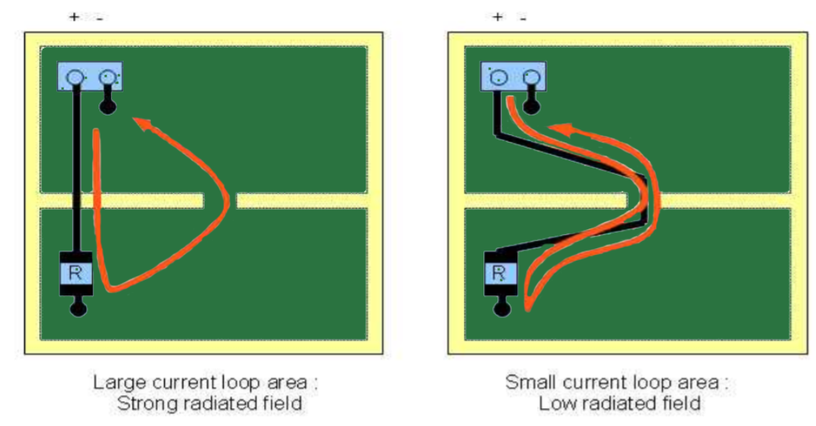
Route to avoid current loops
https://www.protoexpress.com/blog/best-high-speed-pcb-routing-practices/

Slide 45
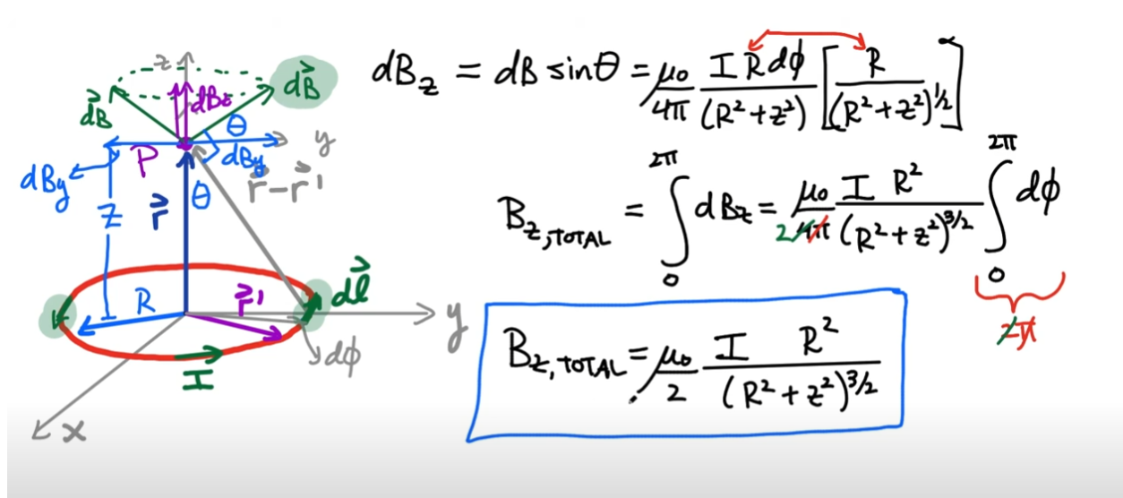
Remember: Your Fields / EM Courses!
https://www.youtube.com/watch?v=nydLMuGB61E&t=13m10s

Slide 46
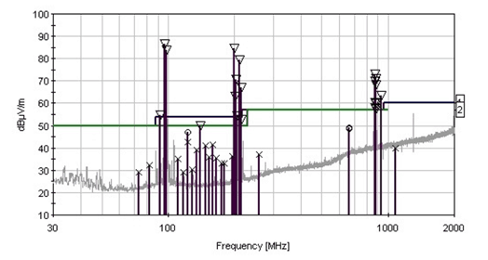
EMC Compliance
https://emcfastpass.com/emc-testing-beginners-guide/emissions/

Slide 47
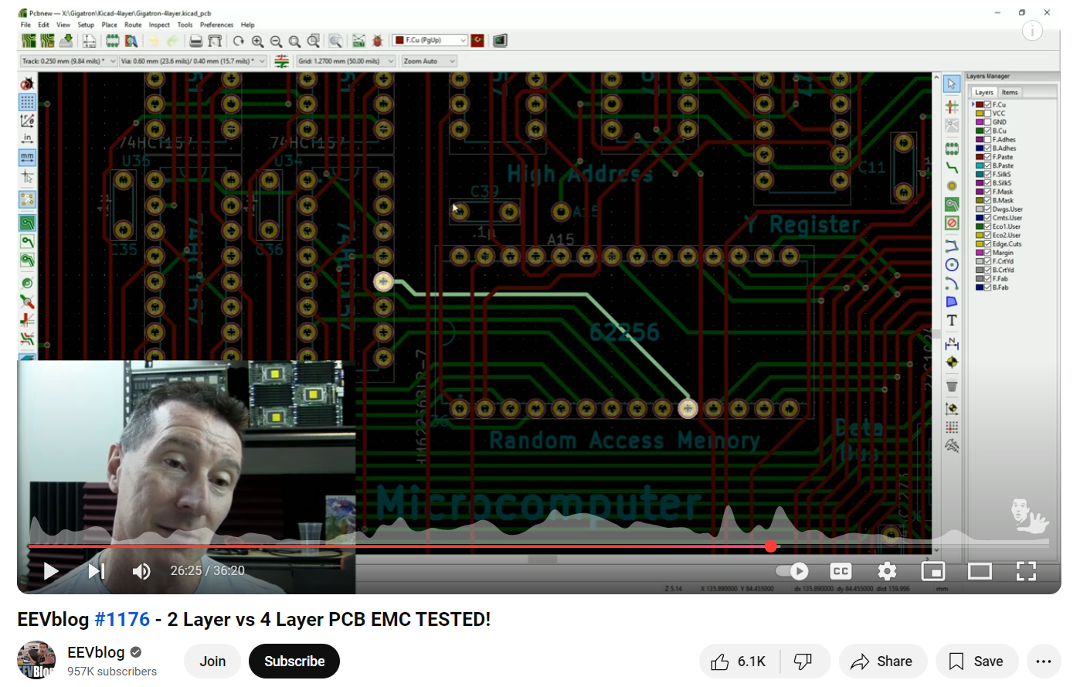
2-Layer PCB vs 4-Layer PCB
https://www.youtube.com/watch?v=crs_QLuUTyQ

Slide 48
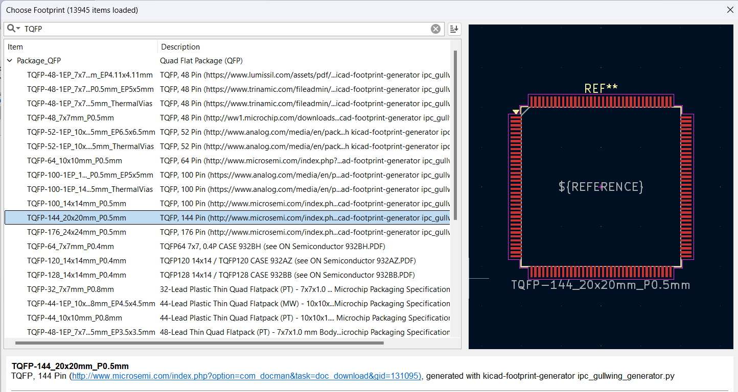
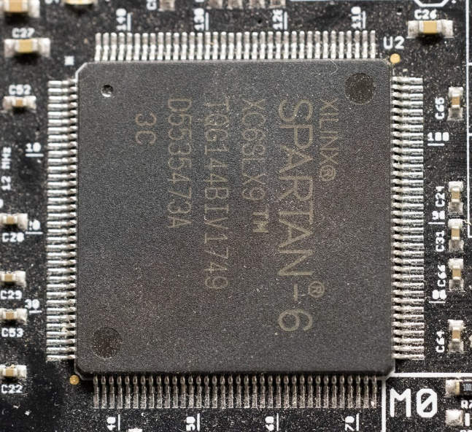
Footprints

Slide 49
Footprints: Standard
Standard footprints designed for production soldering, using solder paste process.
But what if you are doing just a few boards…

Slide 50
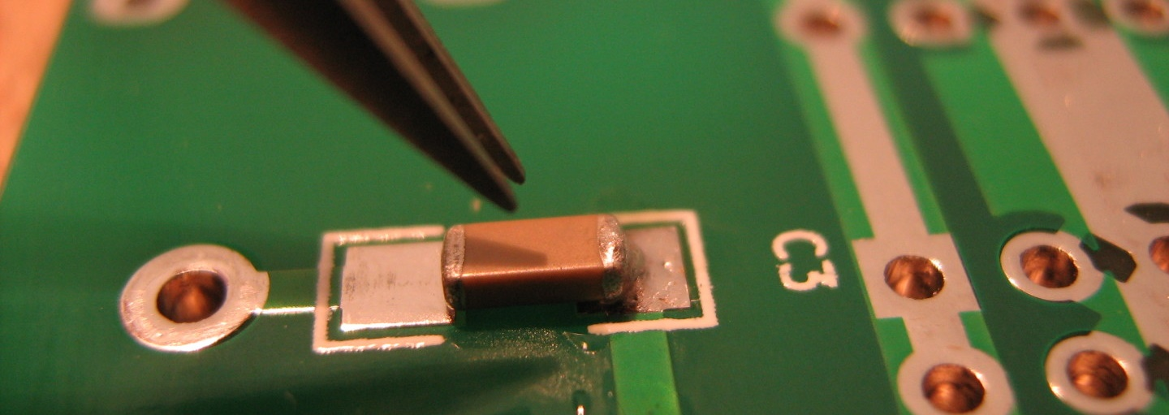
Footprints: Hand Soldering
https://www.davidhaillant.com/smd-soldering/

Slide 51
SMD vs. Through Hole
Surface mount parts can be more difficult to solder, but once you get used to it you may prefer them!
Lots of automated & semi-automated methods you can use for soldering, a few examples in these slides…

Slide 52
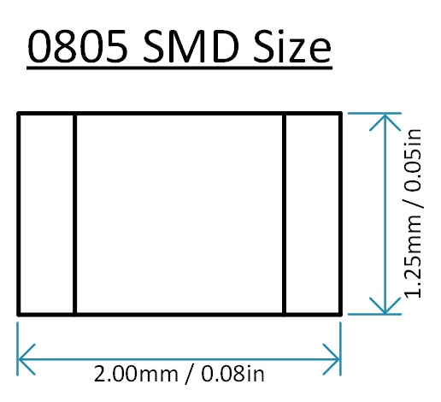
SMD Footprint Sizes
Suggest to use 0805 sizes as a minimum to get started.
In industry, most designs are 0603 where space is not a constraint, 0402 is “normal” where some space constraints.
0201 and smaller are used for space constrained.
NOTE: As size goes down power handling capacity, voltage ratings, etc tend to go down. Very little downside to large packages.
0805 (Inch) = 2012 (Metric)

Slide 53
Checking Footprints!
Footprints may have errors. Good practice to always check them against datasheet.
Also good idea to order parts early & test them on a printed copy of the PCB to ensure things “fit” as you expect.

Slide 54
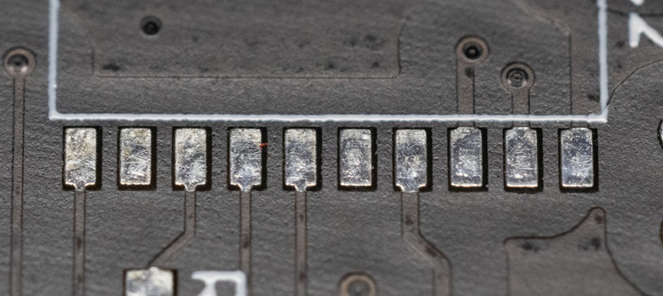
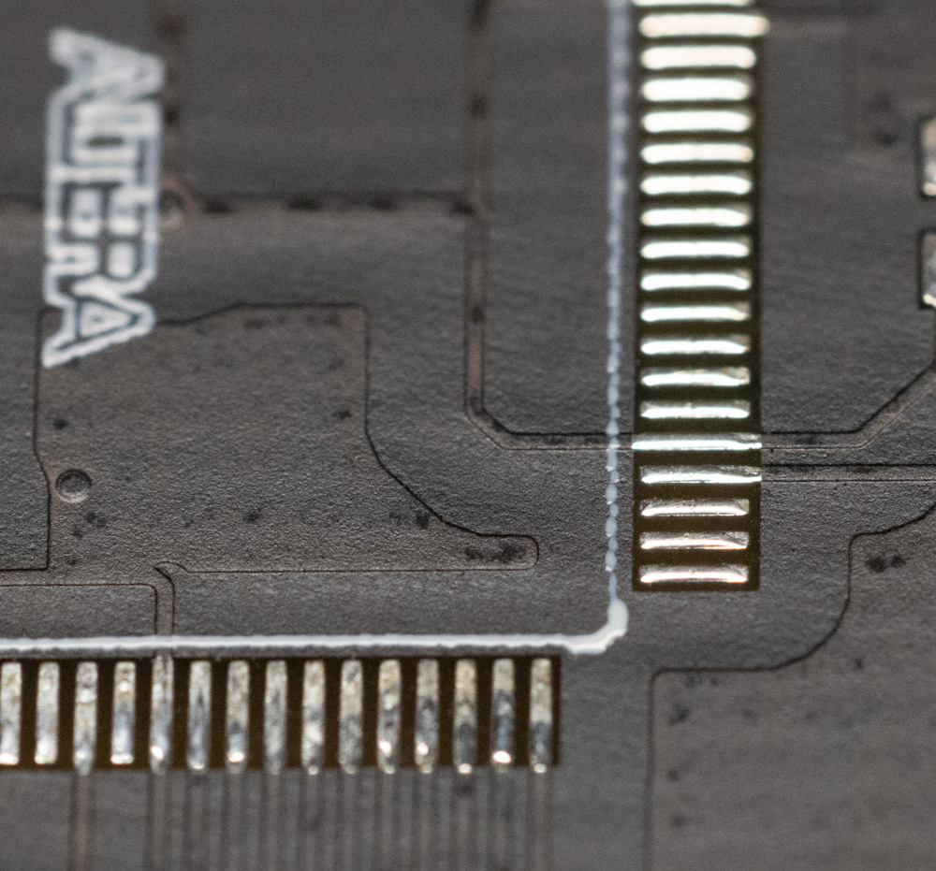
Soldermask Bridges / Dams
Soldermask between pins (wide pitch part)
Soldermask removed between pads – gap would be too small for soldermask process.

Slide 55

Planes & Pours

Slide 56
Let’s assume you’ve got the design already (we’ll see how you can make a design later).
And go onto…

Slide 57
Part 2: Ordering & Submission

Slide 58
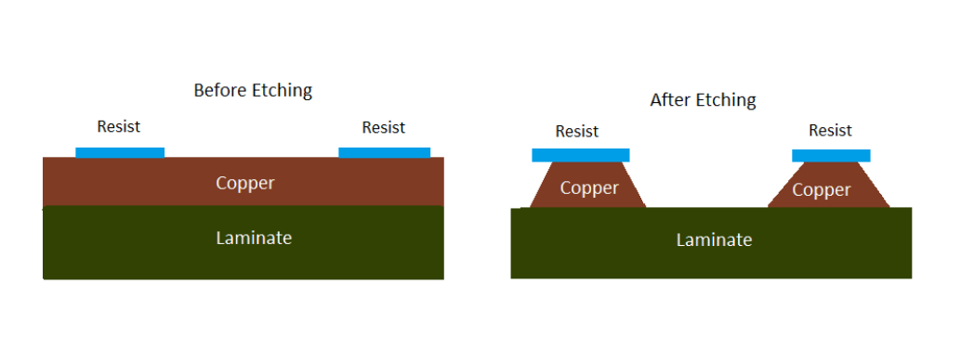
Manufacturing Process
https://www.protoexpress.com/kb/pcb-manufacturing-overview/

Slide 59
DRC / DFM Checks
Design Rule Check (DRC) part of Design For Manufacturability (DFM)
DRC is critical.
Causes delays or broken PCBs.

Slide 60
File Formats
You are mostly going to deal with “Gerbers” & “NC Drill”.
There are more “recent” file formats that you may come across in industry which have much better control on information.
You may also share a netlist with the fab which is used for electrical test (E-Test).

Slide 61
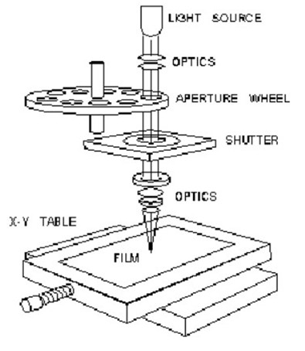
Gerber & NC-Drill
These file formats are old (1960’s), and have a lot of terminology that reflect how the PCBs were made (see left) using a photoplotter.
https://www.eurocircuits.com/gerber-past-present-and-future/

Slide 62
Gerber & NC-Drill
The Gerber files (RS-274-D) contained the traces.
Encoded as selecting an aperture & moving it around. Still the case.
The NC Drill (NC = Numeric Control) contained the drills for vias & holes.
Sometimes called Excellon after a brand name.
You may need to specify your file parameters such as:
Units (mm vs inch)
“Precision” (how many decimal places are used)

Slide 63
README File
Very common to include a “README.txt” file which has details:
Board parameters (size)
File information
Contact information (maybe?)
NOTE: Be careful to avoid OVERSPECIFYING things that you are specifying in the ordering process.

Slide 64
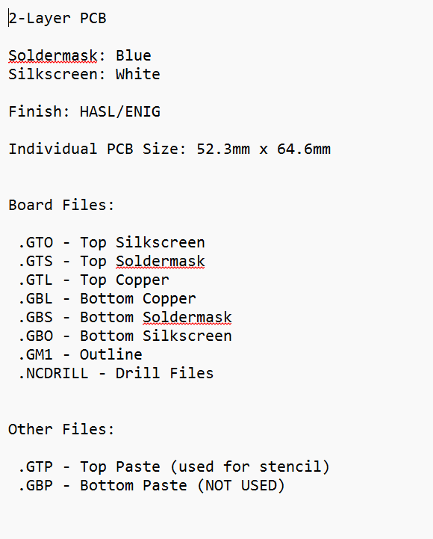
e.g., Minimal README File

Slide 65

e.g., More detailed README File:
Design Technology
8 Layers
Physical stackup details
E-Test Requirement

Slide 66

Sidenote: Inverted Layers?
The green here marks where there isn’t copper on this layer (inverted).
Hole isolated from the plane
Via connected to the plane
Plane layers are often inverted since they are mostly copper. This helps visualize them and keep file sizes lower.
Normally the fabs will pick up on this, but good to specify.

Slide 67

Manufacturing Drawing
Various details of the board manufacturing requirements.

Slide 68
PCB Fabs of Interest
(China) JLCPCB: Currently most popular overseas fab
(China) PCBWay: Access to higher-end processes than JLCPCB, more expensive/less user friendly.
WARNING: Chinese New Year / Spring Festival happens shortly, PCB fabs shut down…
(EU) EuroCircuits: Good website, good prices & speed
(USA) OSHPark: Slower due to shipping here, but great service & very “maker-friendly”.

Slide 69

Quoting via JLCPCB
Upload a .zip file
Layers should be autodetected.
Outline should be autodetected.
Get more than 5 if all group members get one & to have lots of spare for soldering.
1.6mm (0.062”) is normal thickness.
Green may be fastest…
Select Lead-Free or ENIG

Slide 70

README File for Generic Ordering
If I plan on selecting soldermask via JLCPCB interface, don’t specify one here! Chance I forget to update the file which may cause them to hold the job while they confirm what I actually want.

Slide 71

Ordering Full Assemblies
JLPCB can be used for even ordering simple pre-built boards like the one to the left.

Slide 72
Bill of Material (BOM)
BOM is a critical file that contains your parts.
You can maintain this separately OR export it from your design files (preferred).
For JLCPCB they have a special format they want! But generally may look like this:

Slide 73

Pick-n-Place Machine

Slide 74

e.g., Full Production Line
https://www.youtube.com/watch?v=9uet6TNtUXI

Slide 75

PNP / CPL File Format
Manufactures may need specific format – see documentation for your software.

Slide 76



Tape & Reel
https://www.reelservice.com/blog/2018/09/18/the-a-z-glossary-of-tape-reel-part-1-a-h/
https://electronics.stackexchange.com/questions/694163/smd-resistor-rotation-on-tape-and-reel

Slide 77
PNP Gotchas
The rotation of the parts needs to be relative to the part position in the “tape”.
This is especially important with diodes (LEDs) where it won’t be obvious if the part is backwards.
You will often supply documentation to confirm the anode or cathode of each diode.
Some workflows let you do this automatically (JLCPCB, MacroFab, etc).
Always check – it may have something simple like a “pin 1” indicator for LEDs, go check if Pin 1 means anode or cathode & that your files agree!!

Slide 78
JLCPCB Assembly Service
https://cart.jlcpcb.com/quote?fromDemo=yes

Slide 79

JLCPCB Parts (LCSC)
Use special suppliers where possible with JLCPCB – many parts are not available in each others markets.

Slide 80

Finding Replacement Parts
NOTE: The search isn’t that good. Here I tried a few variations (560 resistor, 560 ohm resistor, 560R resistor).
Check carefully on hover-over that it looks reasonable & package size is what I need (0402), then click the item to see all details.

Slide 81

E.g., here “560 0402” is coming up with 5.6K, 56R, 56k, etc

Slide 82
SIDEBAR: Suffixes as Multipliers
Very common to use R as “ohms”, then drop it for higher values. The suffix also becomes the decimal place:
560R = 560Ω
560k = 560kΩ
5k6 = 5.6kΩ
For capacitors, common to use n or u:
100n = 100nF
2u2 = 2.2µF

Slide 83

Placement Preview

Slide 84

Fixing Orientation
See https://jlcpcb.com/help/article/pcb-assembly-faqs-part-2 if using this service.
They rely on silkscreen markings to confirm polarity/rotation.
The previewer may be wrong, this will get fixed later and you will need to confirm it.

Slide 85

Sidebar: Pin 1, Anodes/Cathode Markings
Pin 1 marking is visible with part mounted.

Slide 86

Sidebar: Pin 1, Anodes/Cathode Markings
What does this polygon mean?
Be sure to document if anode or cathode!!

Slide 87

Sidebar on Sidebar: IC Ejection Marks
Pin 1 Marking
NOT pin markings.
These are from moulding process.

Slide 88

Sidebar on Sidebar: IC Ejection Marks
Pin 1 Marking
NOT pin 1.
Ejector marks are much shallower. Look carefully!

Slide 89
Part 3: KiCAD Introduction

Slide 90

Getting / Installing KiCad
https://www.kicad.org/download/

Slide 91


Starting a Simple Project

Slide 92

First Time: Defaults should be OK!

Slide 93
Project: Keep It Simple!
Make a simple first project (See Group Assignment).
Keep a single sheet to avoid learning about hierarchy for now.

Slide 94
Symbols & Footprints
Symbol libraries hold the symbols used on the schematic.
Similar libraries hold the footprints we’ll use to design the PCB.

Slide 95

Schematic Entry

Slide 96

Schematic Entry
Search for “Capacitor”
Click on the Symbol
This is a generic symbol with no footprint. We’ll need to specify one!

Slide 97

Schematic Entry

Slide 98
HINT: Selecting Parts
If selecting parts (like op-amps, microcontrollers, etc) try to stick with parts that are in the library, saves you from making footprints.
Decide on what you are comfortable soldering. If DIY stick with through hole or large SMD. If using JLCPCB Assembly stick with SMD (they prefer SMD to through hole).

Slide 99

Adding Power
The same name gets connected together, actual name doesn’t matter.
But make sure you use the same name for e.g., all your 3.3V nets!

Slide 100

Assigning Footprints
Double-click…
Click…

Slide 101

Assigning Footprints

Slide 102
Assigning Footprints
WARNING: You can assign incompatible footprints. Check carefully what anode/cathode marks to with diodes, and parts like transistors that may have different pinouts available.

Slide 103

Assigning Part Numbers?
Assign value here
I can add other fields to specify specific part numbers.

Slide 104

Hint: Adjusting your Default Template
Set up some defaults if you want them to always be on your symbols!
Saves you from remembering all the fields…

Slide 105

Finding Parts on Digikey / Mouser

Slide 106
Typical Resistor Search
<Live Demo, backup slides >

Slide 107



Slide 108

Filter by highly available and/or lower price. Good enough!

Slide 109
Resistor Quick Ref
Check power handling capacity. If powering bright/large LEDs do calculation of power loss in resistor, keep that at < 50% of rated.
Watch for heating effects – through hole resistors may be preferred here!
1% & 5% resistors are the same price with smaller resistors. Tend to just order 1%...
Don’t get too caught up on anything else for now.

Slide 110



Typical Capacitor Search

Slide 111

Capacitor Biasing Effect

Slide 112

Temperature Coefficient

Slide 113
Capacitor Quick-Ref
Stick to ceramic caps unless you need higher values for e.g., filtering of input power.
WARNING: Some types, such as tantalum, are very sensitive to reverse polarity and over-voltage.
Don’t rate only based on expected voltage! Consider biasing for ceramic caps.
BUT: If you set the voltage TOO high you will pay $$$ or need too large a package.
Capacitor tolerance is looser: ±10% is a good value.
For higher values larger tolerance swings are reasonable.
X7R/X5R is a good temp coefficient to start with, but often not too important.
For sensitive values (such as crystal capacitors) C0G or NP0 are more stable.

Slide 114

Typical LED Search
LED characteristics can vary a lot – maybe you don’t want SMD? Do you want a super-bright LED?

Slide 115

Finding Connectors
Connectors can be tricky to search for. Let’s say I want some standard terminal headers:

Slide 116

Finding Connectors
Always check “In Stock” first!

Slide 117

Visual Clues
Look at photos – for example if I want normal unshrouded connectors, I can see this one is right:
I know to search “Unshrouded” now…

Slide 118


Visual Clues
I can now select “Unshrouded” and hit “Apply All” to filter results again.

Slide 119
Selecting Parts
Selecting parts requires careful consideration of everything we need.
Can be overwhelming at first! Take some time to look through. Use existing designs if you can find them as reference too.
Let’s assume we finished that…

Slide 120


Syncing to PCB
Hit this…
Read warnings or errors – might happen if you have the wrong footprint!
Hit this now.

Slide 121

Placing Parts
Click & drag parts (watch you get the part and not the text).
Hit ‘r’ to rotate while holding down button.
Ratsnest

Slide 122
Placing Effort
Time spent improving placement will make your routing much easier.
This can take some time to develop, since you need some experience routing to understand what makes sense.

Slide 123


Setting up Widths

Slide 124

Routing
Press “x” to start routing. Click on a point and you see the ratsnest follow you:
Press w key to switch between defined trace widths (Shift-W goes backwards).

Slide 125

Online DRC
Online Design Rule Check enabled by default.
Prevents you from doing illegal things like routing trace too close for your design rules.
In this example I cannot drag it through here.

Slide 126

Switching Sides (Via)
Press ‘v’ button to place via. Switches sides automatically!

Slide 127
Autorouter??
Autorouter sounds like it could be magic!
Despite many peoples negativity they can work, but they require a lot of effort defining what you want them to do. In many circumstances not worthwhile.
E.g., you inherently know which traces are high current or sensitive. AutoRouter has no idea, you need to make a class, define the trace widths, etc.
I’ve used them on some boards for tests, rarely pleased with results.

Slide 128

Check Mechanical Size & Add Mounting Holes
Think about how you will mount this:
If fitting in breadboard, mount headers on 0.1” grid space
If bolting to something, make a convenient mounting hole
HINT: Add a “Mounting Hole” part on schematic and assign it a “Mounting Hole” footprint.
This will ensure it stays around and isn’t forgotten!
For mechanical strength some hole patterns have additional small vias within them.

Slide 129


Pretty Up Silkscreen

Slide 130

Pretty Up Silkscreen
Move the reference designators so it doesn’t overlap the other component pads.
Values are for our ref & won’t get printed on silkscreen. We can turn this layer off if it starts to look too messy.

Slide 131


Pretty Up Silkscreen
Press Alt-3 (or view 3D viewer) to check what it will look like.

Slide 132

Add Outline
Add a closed outline on the EdgeCuts layer

Slide 133
Ground Pours
Consider adding ground pours.
Make sure you have some vias to GND they will connect to!
…we’re going beyond the time limit here, see many of the other great tutorials…

Slide 134


DRC Checks

Slide 135

Exporting Files

Slide 136

Exporting Files
1. Put a folder here such as “gerber_outputs”
This will keep all your files together so you don’t miss one!
2. Then press this button.
3. Then press this button.

Slide 137

Exporting Files Cont’d
This should have been populated automatically. Same as gerbers!
2. Then press this button.
3. Then close everything.

Slide 138

Zipping Together
Zip all the files.
Sanity check the dates/times are within a few mins of each other.
(In case a file didn’t export)

Slide 139


Testing
Check the preview! Should match what you expect.
Drag your file here
(Example error: I didn’t include a board outline in kicad so this is cut too close!)

Slide 140
Part 4: Prototype Bring-Up

Slide 141
Soldering 101
Hopefully you have previous soldering experience!
Modify your design based on your team(s) experience, OR plan on ordering preassembled boards.

Slide 142
SMD Soldering Guides
Surface mount soldering is often done with solder paste.
Can also do it with regular solder – use lots of flux if so!

Slide 143

Hand Soldering & Low-Cost
I've got a guide from 2003:
https://colinoflynn.com/wp-content/uploads/2025/01/smd_soldering.pdf

Slide 144

Solder Paste
Solder spheres & flux mixed together.
Often needs to be stored at low temp or the flux becomes too liquid & separates!
Available in tubes (left) and tubs.

Slide 145
Solder Paste Usage
Best usage with a stencil (can order with PCB).
But can also use a toothpick to “paint” on pads. If you are careful this will work with multi-package SMD well!
See the next three videos…

Slide 146

e.g., Hand Assembly Example
https://www.youtube.com/watch?v=-DMYJmB4naA
https://colinoflynn.com/2015/10/low-cost-smd-soldering-setup/

Slide 147

e.g., Hand Assembly Example screenshot
https://www.youtube.com/watch?v=-DMYJmB4naA

Slide 148

Soldering with a Skillet
https://www.youtube.com/watch?v=i8zzNZV8AlU&t=2s

Slide 149
REMEMBER THE GOLDEN RULE
Design your board for how you plan on getting it made and built.
If you might use skillet assembly, keep all SMD parts on top side only!

Slide 150
Bring-Up Best Practices
If assembling your own board:
Assembly a smaller portion and test at a time.
E.g., I may build up the power supply section of a board first
Use current limited power supplies if possible (if board doesn’t need max current initially).
Confirm as much as you can is working before doing “dangerous” things (like triggering a high-current mode).

Slide 151

Thermal Camera Checks
Use of a thermal camera can be helpful on important bring ups to watch for “hot spots” before you feel (or smell) them:

Slide 152


Bodging & Repairs
You may need to modify the PCB to fix things! Typical operations:
1. Cut a trace – easy to use a small drill bit for this (handheld):

Slide 153

Bodging & Repairs
2. Solder a bodge wire to fix a missing connection. Often used in combination with the drilling to re-route.
Or to repair (as in right)
https://personal.garrettfuller.org/

Slide 154
Further Learnings
That’s it! There is tons (and tons) of information out there:
Reference books
YouTube (EEVBlog has a lot of videos on these topics)
Forums
Don’t get overwhelmed – make mistakes. Ignore some of the online overly pedantic advice. Have fun!

